Slide 1
© 2018 Cengage Learning®. May not be scanned, copied or duplicated, or posted to a publicly accessible website, in whole or in part.

Slide 2
Pricing
9
© 2018 Cengage Learning.® May not be scanned, copied or duplicated, or posted to a publicly accessible website, in whole or in part.

Slide 3
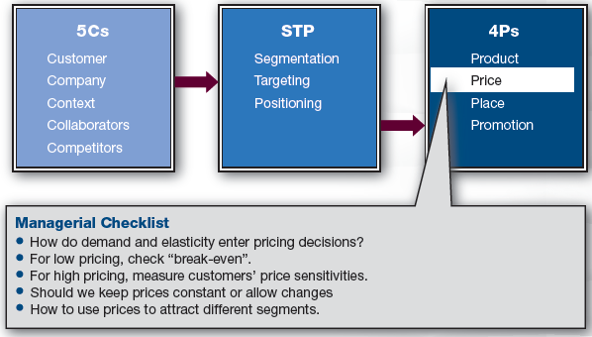
Marketing Framework

Slide 4
Discussion Questions #1
What would you pay for a Pepsi? Why?
What would you pay for a Pepsi at a movie theater? Why?

Slide 5
Why Is Pricing Important?
Price obtains value back from customers
Marketers set optimal pricing
Pricing …
Matches brand positioning
Affects demand
Can be used as a segmentation tool

Slide 6
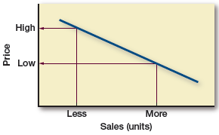
Demand Curve/Line
Demand tends to decrease as price increases

Slide 7
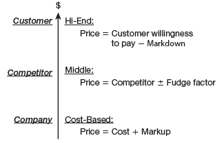
Simple Pricing Strategies
The Cs of marketing directly affect pricing

Slide 8
Pricing and Profitability
Profit (π) = (Price × Demand) – (Fixed costs) – (Variable costs × Demand) = (Price – Variable costs) × Demand – (Fixed costs)
Profit increases as price increases
However, demand decreases when price increases
Need to find a happy medium

Slide 9
Pricing and Elasticity
Elasticity
How much does demand (units sold) increase (or decrease) with a price change?
e.g., If decrease price, does volume increase cover lost revenue?
Inelastic: demand barely changes
Elastic: demand changes

Slide 10
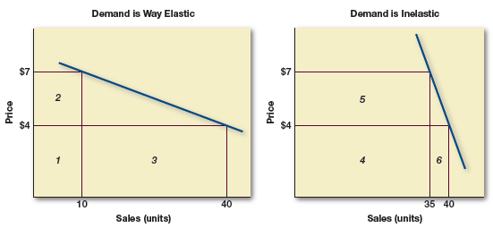
Elastic vs. Inelastic Demand
Inelastic demand implies that customer will purchase even if price increases

Slide 11
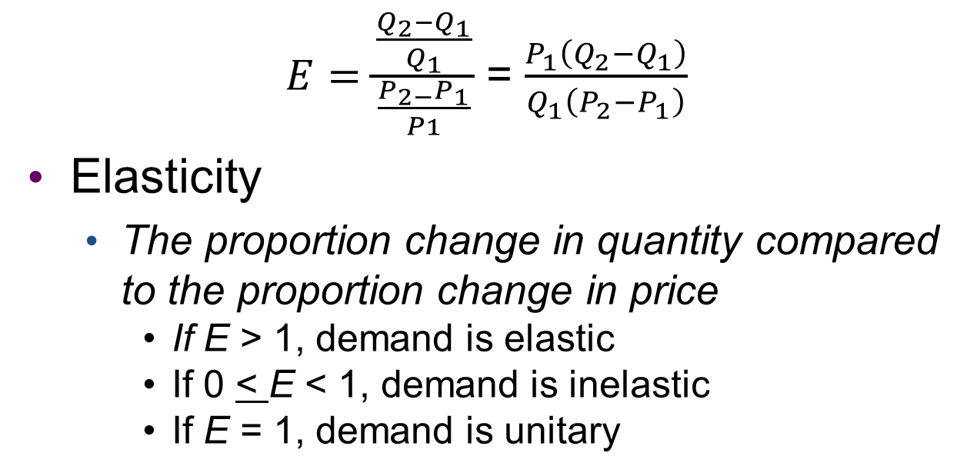
Calculating Elasticity (slide 1 of 2)
$E=\frac{\frac{Q_{2}−Q_{1}}{Q_{1}}}{\frac{P_{2−}P_{1}}{P1}}$ = $\frac{P_{1}\left(Q_{2}−Q_{1}\right)}{Q_{1}\left(P_{2}−P_{1}\right)}$
Elasticity
The proportion change in quantity compared to the proportion change in price
If E > 1, demand is elastic
If 0 < E < 1, demand is inelastic
If E = 1, demand is unitary

Slide 12
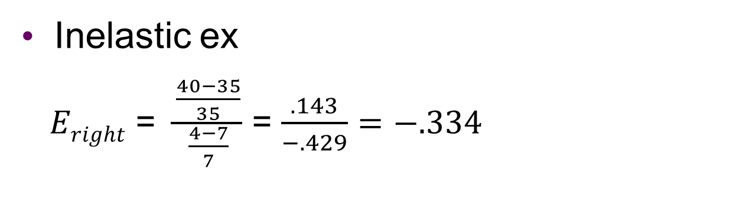
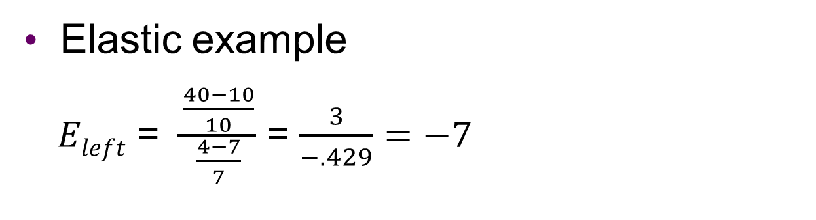
Calculating Elasticity (slide 2 of 2)
Elastic example
$Eleft$ = $\frac{\frac{40−10}{10}}{\frac{4−7}{7}}$ = $\frac{3}{−.429}=−7$
Inelastic ex
$Eright$ = $\frac{\frac{40−35}{35}}{\frac{4−7}{7}}$ = $\frac{.143}{−.429}=−.334$

Slide 13
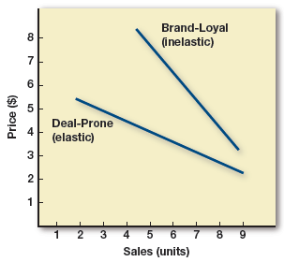
Elasticity and Customer Segments
Elasticity varies with customer segments

Slide 14
Factors That Drive Demand
Demand increases if
Customers’ desire for the brand increases
Perceptions of product’s benefits and brand images increase
Competitive products are poor or priced higher
There are few good substitutes

Slide 15
Price Sensitivity
Price sensitivity is greater when
Customers
Don’t care much about the purchase
Don’t have strong preferences
Don’t have strong brand loyalty
Have limited income
The item is a luxury rather than a necessity
There are many substitutes
The purchase is large relative to income
It is easy to compare prices

Slide 16
Discussion Question #2
Do you think most customers are price- sensitive when buying a car? Why?

Slide 17
Low Prices
Two considerations:
You need to cover your costs
Compute a variety of break-evens
Number of units needed to make money
You need to determine if you want to have a constant low price strategy (Walmart) or a fluctuating one (Kohl’s)

Slide 18
Covering Costs
Firms need to cover costs
Costs set the minimum floor on pricing
Cost-plus pricing: Unit cost/1 – X%)
Where X% is the intended return
If fixed costs are high relative to variable costs, maximize volume
If variable costs are high, maximize per unit margins

Slide 19
Break-Even Analysis
Break-even (BE)
Number of units to sell to cover costs
Can be computed in terms of number of units sold or monetary values
BE = Fixed costs/(Price – Variable costs)

Slide 20
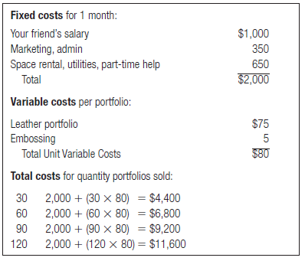
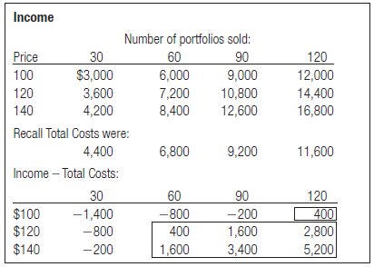
Break-Even for a Good
Costs for
Portfolio
Business
Break-Even
for Portfolio
Business

Slide 21
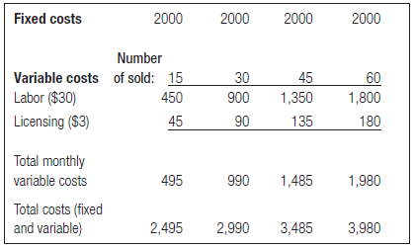
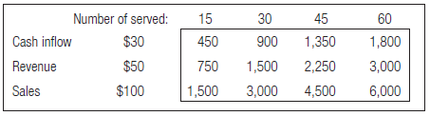
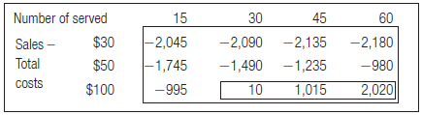
Break-Even for a Service
Costs for
Tablet Customization Service
Business
Break-Even
for Tablet Customization Service
Business

Slide 22
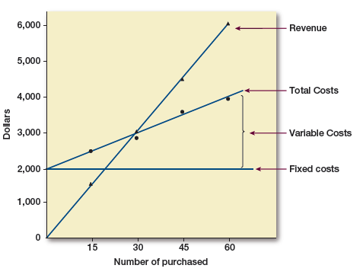
Break-Even, if Service Fee = $100

Slide 23
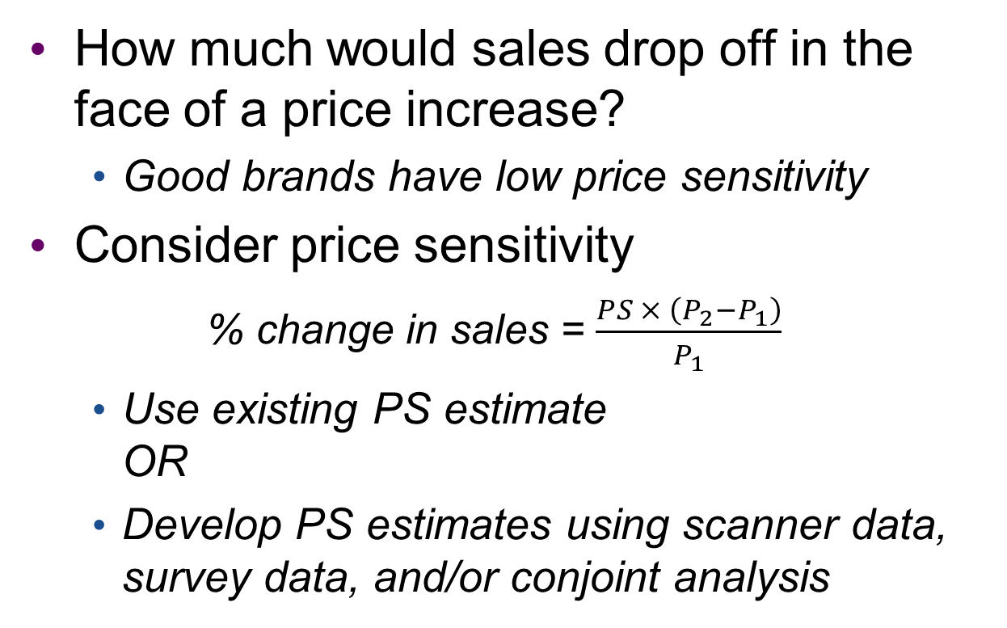
High Prices and Price Sensitivity
How much would sales drop off in the face of a price increase?
Good brands have low price sensitivity
Consider price sensitivity
% change in sales = $\frac{PS × \left(P_{2}−P_{1}\right)}{P_{1}}$
Use existing PS estimate OR
Develop PS estimates using scanner data, survey data, and/or conjoint analysis

Slide 24
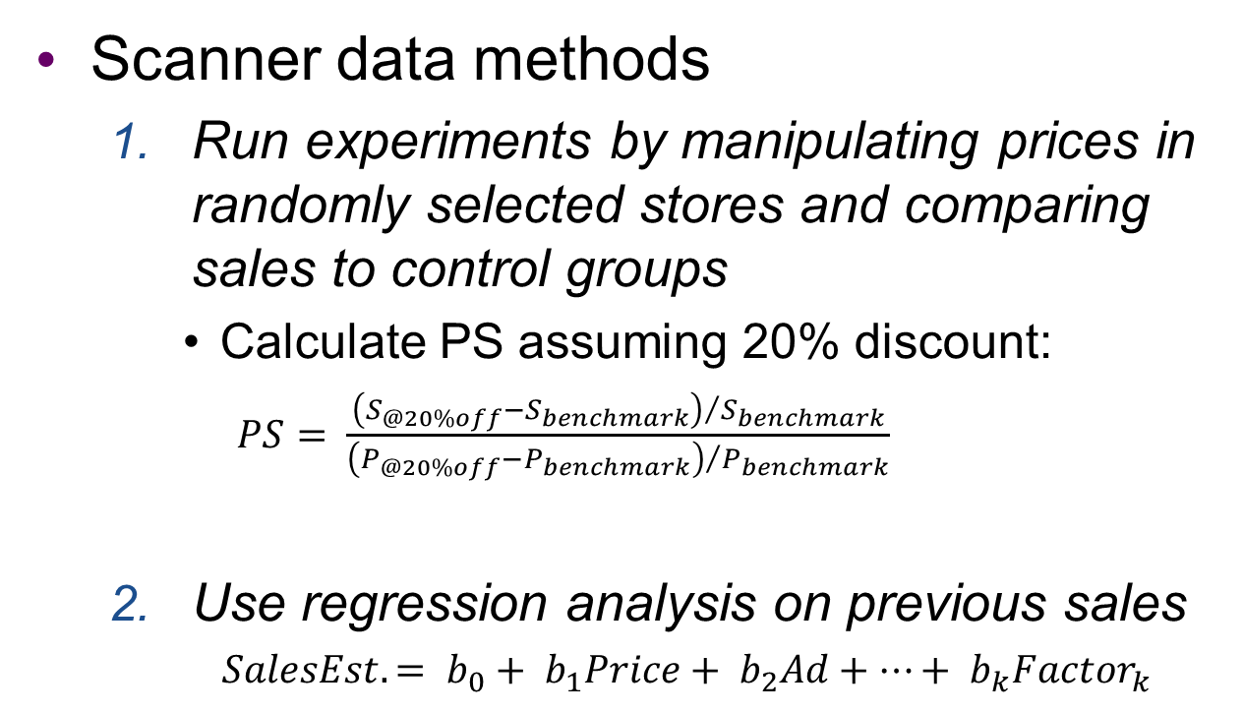
Price Sensitivity and Scanner Data
Scanner data methods
Run experiments by manipulating prices in randomly selected stores and comparing sales to control groups
Calculate PS assuming 20% discount:
$PS= \frac{{\left(S_{@20\%off}−S_{benchmark}\right)}/{S_{benchmark}}}{{\left(P_{@20\%off}−P_{benchmark}\right)}/{P_{benchmark}}}$
Use regression analysis on previous sales
$SalesEst. = b_{0}+ b_{1}Price+ b_{2}Ad+…+ b_{k}{Factor}_{k}$

Slide 25
Price Sensitivity and Survey Methods
Conduct a survey to assess willingness to pay (WTP)
$25.00 definitely would not buy 1 2 3 4 5 6 7 definitely would buy
$35.00 definitely would not buy 1 2 3 4 5 6 7 definitely would buy
Conduct price studies
Surveys are identical except pricing
A may have higher price than B, B than C, etc.
Each customer fills out an assigned survey

Slide 26
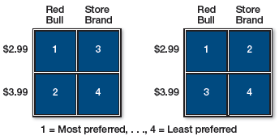
Price Sensitivity and Conjoint Analysis
Show product combinations with price; ask “Which do you most prefer?” “Next?”
Two segments are represented below
Left segment wants the brand and will pay more
Right segment gives up brand for lower price

Slide 27
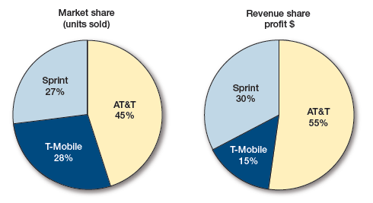
Pricing Question
Given the figures, explain the difference between Sprint and T-Mobile.

Slide 28
Units or Revenue; Volume or Profits
Profit = Revenue – Expense and Revenue = Price × Quantity sold
To maximize profits, find a price where any further increase in price would lead to a large falloff in quantity sold
Profit maximization: marginal revenue equals marginal cost

Slide 29
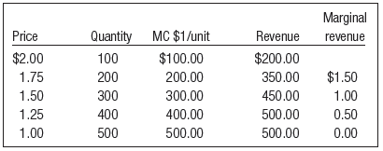
Profit Maximization
Marginal revenue = Marginal cost at $1.00

Slide 30
Systematic Biases in Pricing (slide 1 of 5)
No pricing model is perfect
There are systematic biases in pricing
Price serves as a quality cue; higher price may be more appealing
However, studies show no correlation between price and quality for most product categories
Price contributes to expectations

Slide 31
Systematic Biases in Pricing (slide 2 of 5)
Consumers process absolute and relative numbers differently
Absolute: $15 off of a $199 item and $15 off of a $49 item is the same in absolute terms
Relative: $15 of $199 is 8% while $15 of $49 is 31%
Contextual frame
$499 trip = a $599 trip − $100 discount
However, the $599 trip seems like a better deal because of the higher starting price

Slide 32
Systematic Biases in Pricing (slide 3 of 5)
Price discounts are mood inductions
Temporary price discounts make customers think they are smart shoppers
Prices ending in 99
Prices like $4.99 or $49.99 tend to be more attractive than $5 or $50
People read right to left; thus, the 4 is processed first and leaves an impression

Slide 33
Systematic Biases in Pricing (slide 4 of 5)
Mental accounting
People categorize and budget purchases
People pay less attention to future
e.g., Vacation money is different than food money
Compromise effect
The inner/middle choice between two extremes is attractive
People assume that if a company charges more, it must be providing more

Slide 34
Systematic Biases in Pricing (slide 5 of 5)
Referent pricing
People compare price to some referent, either an externally available price or an internally stored price
External
“MSRP is $49.99, now available for $35.99!”
“Our price $34.99, compare at $45.00!”
Internal
Relevant memory
Inferences about store, etc.

Slide 35
Discussion Questions #3
Discuss the pricing biases at work in the following examples:
A house builder has three price points on kitchen cabinets
A price tag that reads “was $299 now only $199”
A toy package that reads, “This toy is not only fun but also educational.”

Slide 36
Price Discrimination
Price discrimination is illegal
Illegal to charge different prices to different people for the same goods or services
Segment pricing is legal
Different segments value different things
Customers might be annoyed to learn that others paid a lower price

Slide 37
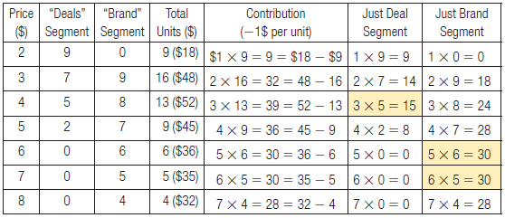
Pricing Questions
What is the ideal price for the deal-prone customers?
What is the ideal price for the brand-loyal customers?
How could you appeal to both?

Slide 38
Quantity Discounts/Yield Management
Quantity discounts: the more purchased, the more saved
Yield management: using price and scheduling to manage demand
e.g., Movies during the day for less money
Need to manage perceptions of fairness

Slide 39
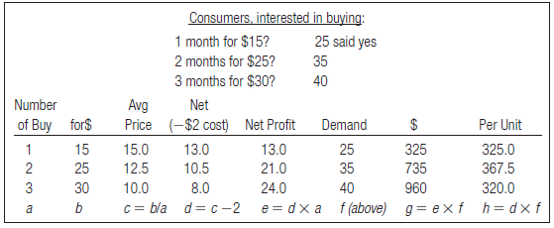
Pricing with a Quantity Discount

Slide 40
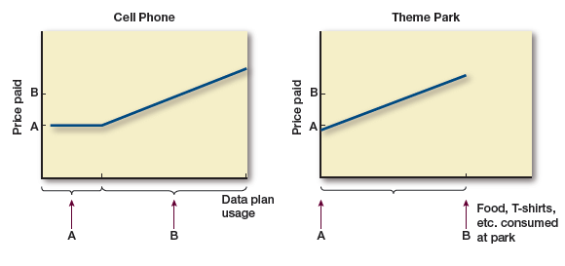
Two-Part Tariffs
Charge a fixed and variable usage fee
Price two parts separately

Slide 41
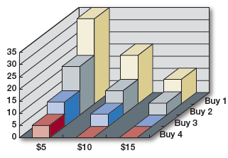
Concept in Action: Discussion Question
35 respondents would go once monthly to a wine bar with a $5 cover; 20 would go twice at $5; 10 would go once monthly at $15, etc. Assumes $2 variable cost
What is the most profitable price?

Slide 42
Product Life Cycle Pricing
Introduction stage
Penetration pricing: seek market share
Price low to stimulate sales, encourage trial, and trigger word-of-mouth
Skimming pricing: seek profit
Price high initially, then lower to make product more accessible
Adjust price in various stages; usually end with lower prices in decline stage

Slide 43
Price Fluctuations
Temporary cuts may be negative
Competitors can imitate; thus, impact may be negated while also squeezing margins
Price drops attract disloyal customers
Customers may stock up
May negatively affect brand image

Slide 44
Coupons
Coupons are relevant only to coupon clippers
Redemption rate is only about 1%
Effective at encouraging new customers to try new products and brand extensions

Slide 45
Game Theory
Game theory is used to estimate likely results of price cuts and competitive response
Marketers need to think about the broader market and competitive responses, not just their own decisions
Mutual cooperation can yield even better outcomes than both parties acting selfishly

Slide 46
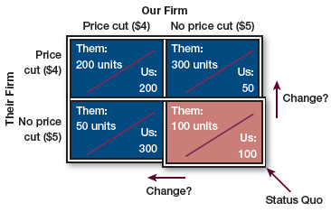
Discussion Questions #4
Can you explain the chart in terms of competitive response?
What do you think the ultimate outcome would be in this scenario? Why?

Slide 47
Auctions
Price is negotiated by buyer and seller
Bidders compete to buy item
Sealed or open bid
Reservation price: estimate of customer’s willingness to pay
If the price is higher than reservation, don’t buy; if it is lower, then buy
English auctions: bids start low & increase
Dutch auctions: bids start high & decrease

Slide 48
Value
Value
An assessment of what the customer gets compared with what the customer gives up
It is usually not a good idea to compete on price
Find benefits your customers want and charge for them

Slide 49
Managerial Recap (slide 1 of 2)
Pricing strategies are basically low, medium, or high
Company and its costs can dictate the lower-bound price
Customers’ willingness to pay marks the upper bound
In the middle, price is tweaked up or down relative to competitors’ prices

Slide 50
Managerial Recap (slide 2 of 2)
Pricing can be used to
Shape a brand’s positioning
Attract/repel different targets
There are economic and psychological elements to pricing

